Slide 1



Transylvania Cloud
AWS Certifications
How To Keep Being Awesome During Pandemic Times
2021

Slide 2
Agenda
17:00 Intro
17:05 AWS Solution Architect Associate – Florin Pavel, Marius Petrovan (Micro Focus), Calin Ardelean (8x8)
17:35 AWS DevOps Professional – Lucian Revnic (Micro Focus)
17:45 Bittnet Trainings for AWS – Mircea Musetescu (Bittnet)
17:55 Closing activities

Slide 3

1000
Transylvania Cloud
https://www.meetup.com/TransylvaniaCloud
members

Slide 4





Intro
Transylvania Cloud
17
events
30
speakers

Slide 5
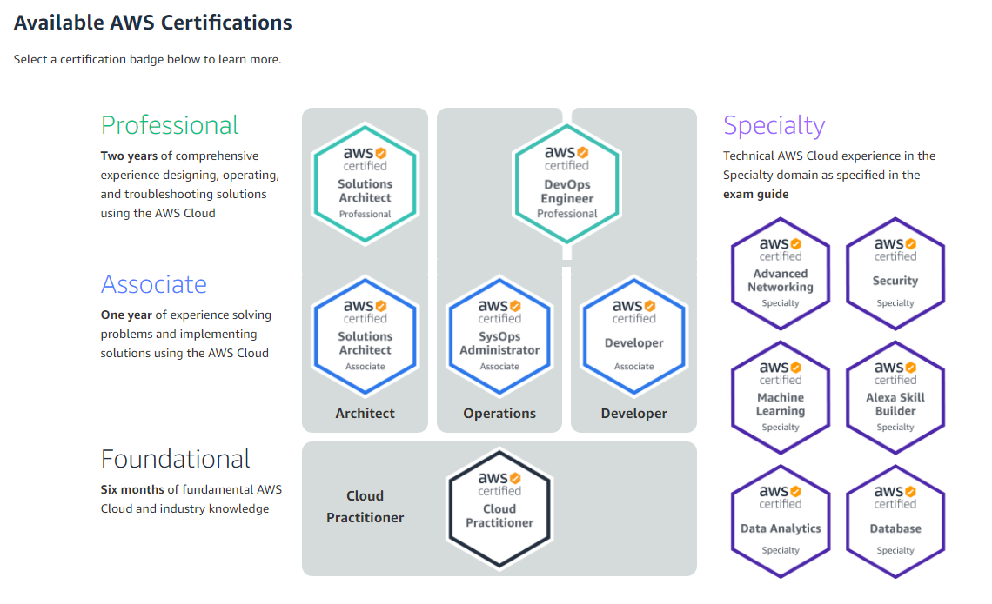

Slide 6

AWS Solution Architect Associate
Florin Pavel – R&D Manager, Micro Focus
Marius Petrovan - R&D Engineer, Micro Focus
Calin Ardelean - DevOps Engineer, 8x8
Transylvania Cloud

Slide 7
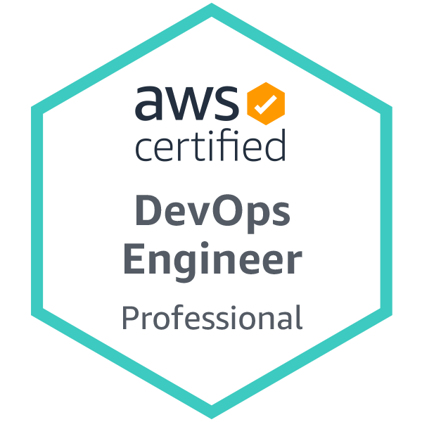
AWS DevOps Pro
Lucian Revnic - Software Architect, Micro Focus
Transylvania Cloud

Slide 8

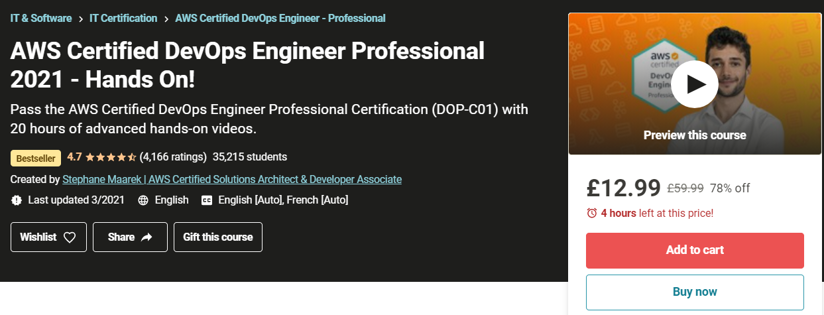

AWS DevOps Professional Certification
Linux Academy
75 questions/scenarios
30 Minutes Accommodation
180 minutes
Save some money on Udemy
Focus on:
DevOps in general, CloudWatch, EB, Cloud Formation, Kinesis, OpsWorks and more
… and more using certification voucher

Slide 9
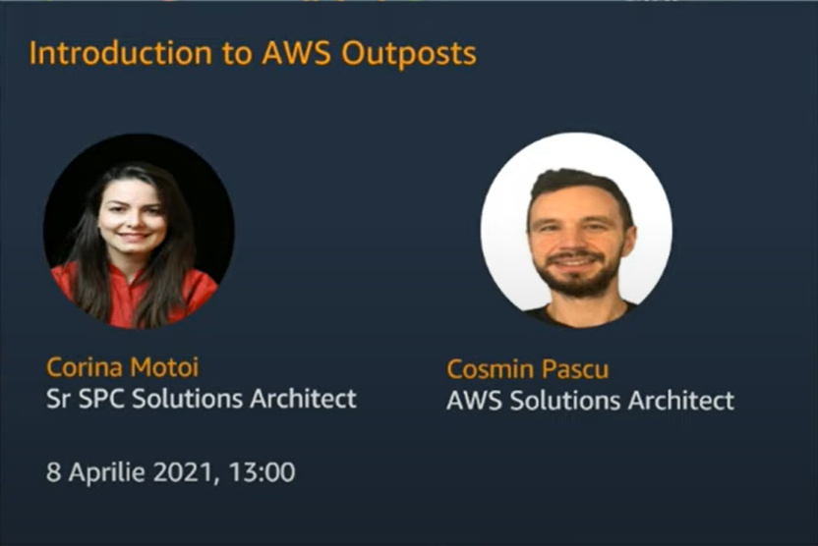

Next cloud related events
Scaling Containers on AWS
with Vlad Ionescu (AWS Hero)
March 30th
https://www.meetup.com/TransylvaniaCloud/events/275768743/
AWS Romania Event
https://www.youtube.com/channel/UCJAP1yNuX_w3fEwMFEVw57A

Slide 10

Resources
Transylvania Cloud on Slack
https://www.youtube.com/channel/UCJAP1yNuX_w3fEwMFEVw57A
Join here: https://join.slack.com/t/transylvania-cloud/shared_invite/zt-n8c8rayr-Pnvi1sMO5y3ki79Dwxe1SQ
(Link expires in 30 days)

Slide 11


Thank you!

